Slide 1
Activation Functions, Linear Layers, and Loss Functions
CSCI 4150/6050: Computer Vision
Many of the slides are from
Professor David Wingate (BYU)

Slide 2
The Three Pieces of Deep Learning
Labeled Data
  Do I have enough ground truth labels and images?
A Neural Network
  What mathematical operations am I performing on the images?
A Loss Function
  How does the network know when it is doing well?

Slide 3
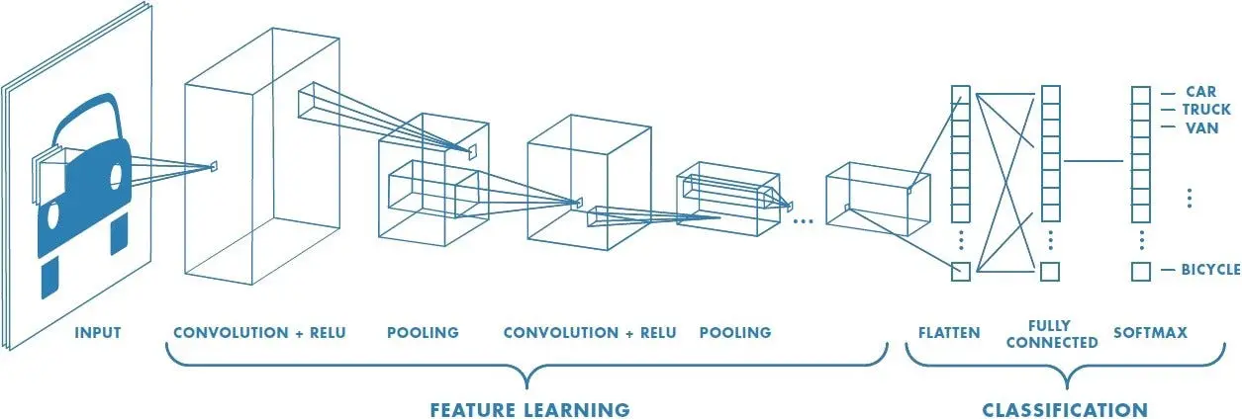
Convolutional Neural Networks (CNNS)
Use standard convolution as your feature extractor, but let the neural networks learn the weights.
Learn the classification targets at the same time you learn the weights.
Image Credit: Sumit Saha

Slide 4
The pieces of a CNN
Convolution
  What should the features be?
Activation Function
  How do I filter out irrelevant features?
Pooling
  How do I analyze features at different scales?
Linear Layers
  How do I classify based on the features I have?

Slide 5
Key Idea: Nonlinearity
One aspect of “Deep” learning is that convolutions are separated by nonlinear activation functions.
Any CNN without nonlinearity, no matter how deep, could be rewritten as a single (sparse) matrix multiply.
Thus, introducing nonlinearity gives the neural network “filtering” capabilities that traditional approaches don’t have.

Slide 6
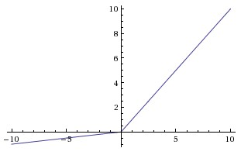
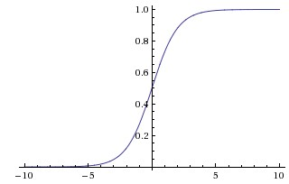

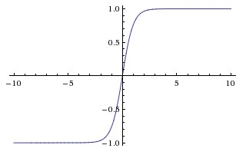


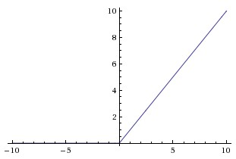
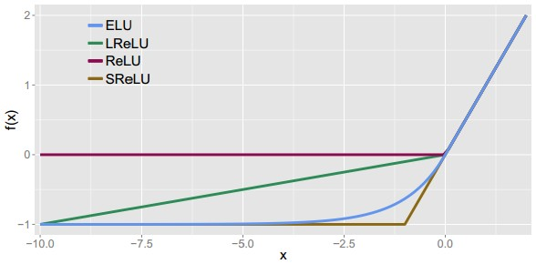
Leaky ReLU
max(0.1x, x)
Activation functions
Sigmoid
Maxout
tanh tanh(x)
ELU
ReLU max(0,x)

Slide 7
Activation functions
Computes f(x) = max(0,x)
Effective way to select feature outputs by keeping only positive values
Very computationally efficient
What is the gradient
when x < 0?
ReLU
(Rectified Linear Unit)

Slide 8

Activation functions
[Mass et al., 2013]
[He et al., 2015]
Effective feature selection
Computationally efficient
Will not “kill” outputs.
May slow down convergence compared to standard ReLU
Not differentiable at 0
Leaky ReLU

Slide 9
TLDR: In practice, you should
Use ReLU. Be careful with your learning rates
Try out Leaky ReLU / Maxout / ELU

Slide 10
The pieces of a CNN
Convolution
  What should the features be?
Activation Function
  How do I filter out irrelevant features?
Pooling
  How do I analyze features at different scales?
Linear Layers
  How do I classify based on the features I have?

Slide 11
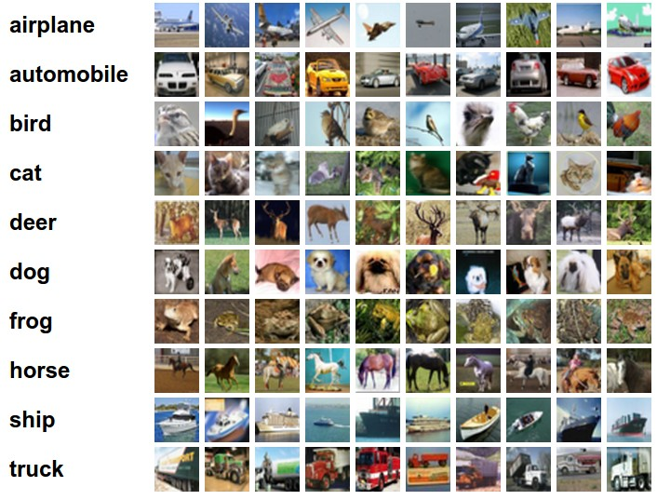
Example dataset: CIFAR-10
10 labels
50,000 training images
each image is 32x32x3
10,000 test images.

Slide 12
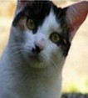
Goal: Classifier
10 numbers, indicating class scores
Convolutional
Neural Network
[32x32x3]
array of numbers 0...1

Slide 13
Goal: Classifier
?
10 numbers, indicating class scores
Convolution Layer,
Max Pool,
…
[2x2x256]
[32x32x3]

Slide 14
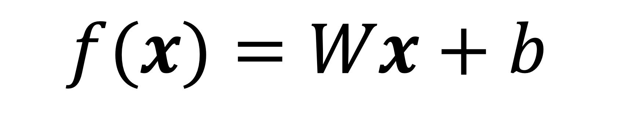
Solution: Linear Layers
The linear layer maps a specific input size to a specific output size through a matrix multiply of learned weights.
Usually, it is followed by the addition of a learned vector bias.
Output from the convolution layers and pooling is “flattened” (i.e. turned into a N x 1 vector) and then fed through the linear layer.
$$f(x)=Wx+b$$

Slide 15
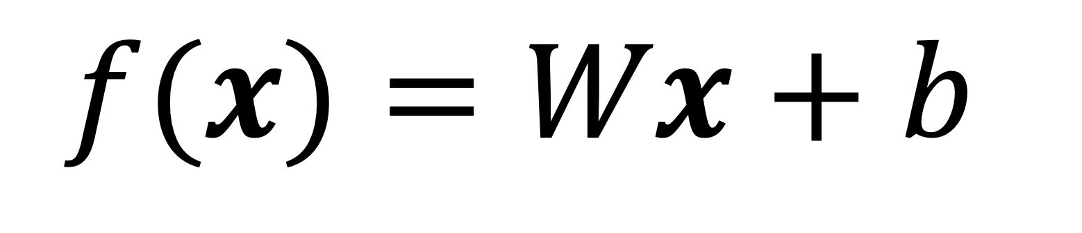
Linear Layer
$$f(x)=Wx+b$$
Convolution Layer,
Max Pool,
…
Flattening
Linear Layer
[2x2x256]
[32x32x3]
W= [10x1024]
b=[10x1]
[10x1]
[1024x1]

Slide 16
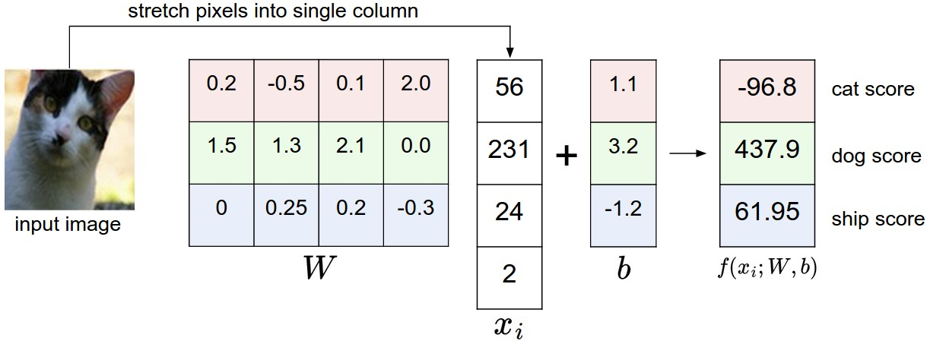
Simple example with 4 x 1 pixels, and 3 classes (cat/dog/ship)

Slide 17

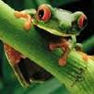
Linear Layer/Scoring Function
- The output from the linear layer is unbounded (i.e. can have any positive or negative value)
- It acts as a scoring function for predicting how much an image looks like each class
- For a given image, the class with the highest score wins!
-3.45
-8.87
0.09
2.9
4.48
8.02
3.78
1.06
-0.36
-0.72
-0.51
6.04
5.31
-4.22
-4.19
3.58
4.49
-4.37
-2.09
-2.93
3.42
4.64
2.65
5.1
2.64
5.55
-4.34
-1.5
-4.79
6.14

Slide 18
Putting it All Together: VGG16
138 million parameters

Slide 19
Let’s Try It in Pytorch!

Slide 20
The Three Pieces of Deep Learning
Labeled Data
  Do I have enough ground truth labels and images?
A Neural Network
  What mathematical operations am I performing on the images?
A Loss Function
  How does the network know when it is doing well?

Slide 21
Loss function/Optimization
Define a loss function that quantifies our unhappiness with the scores across the training data.
Come up with a way of efficiently finding the parameters that minimize the loss function. (optimization)
-3.45
-8.87
0.09
2.9
4.48
8.02
3.78
1.06
-0.36
-0.72
-0.51
6.04
5.31
-4.22
-4.19
3.58
4.49
-4.37
-2.09
-2.93
3.42
4.64
2.65
5.1
2.64
5.55
-4.34
-1.5
-4.79
6.14

Slide 22

Suppose: 3 training examples, 3 classes.
With some W the scores are:
Rather than unbounded numbers, it would be nice to represent the scores as confidence scores between 0 and 1.
In other words, we want a probability distribution across classes.
How can we do this?
cat
3.2
1.3
2.2
car
5.1
4.9
2.5
-1.7
2.0
-3.1
frog

Slide 23
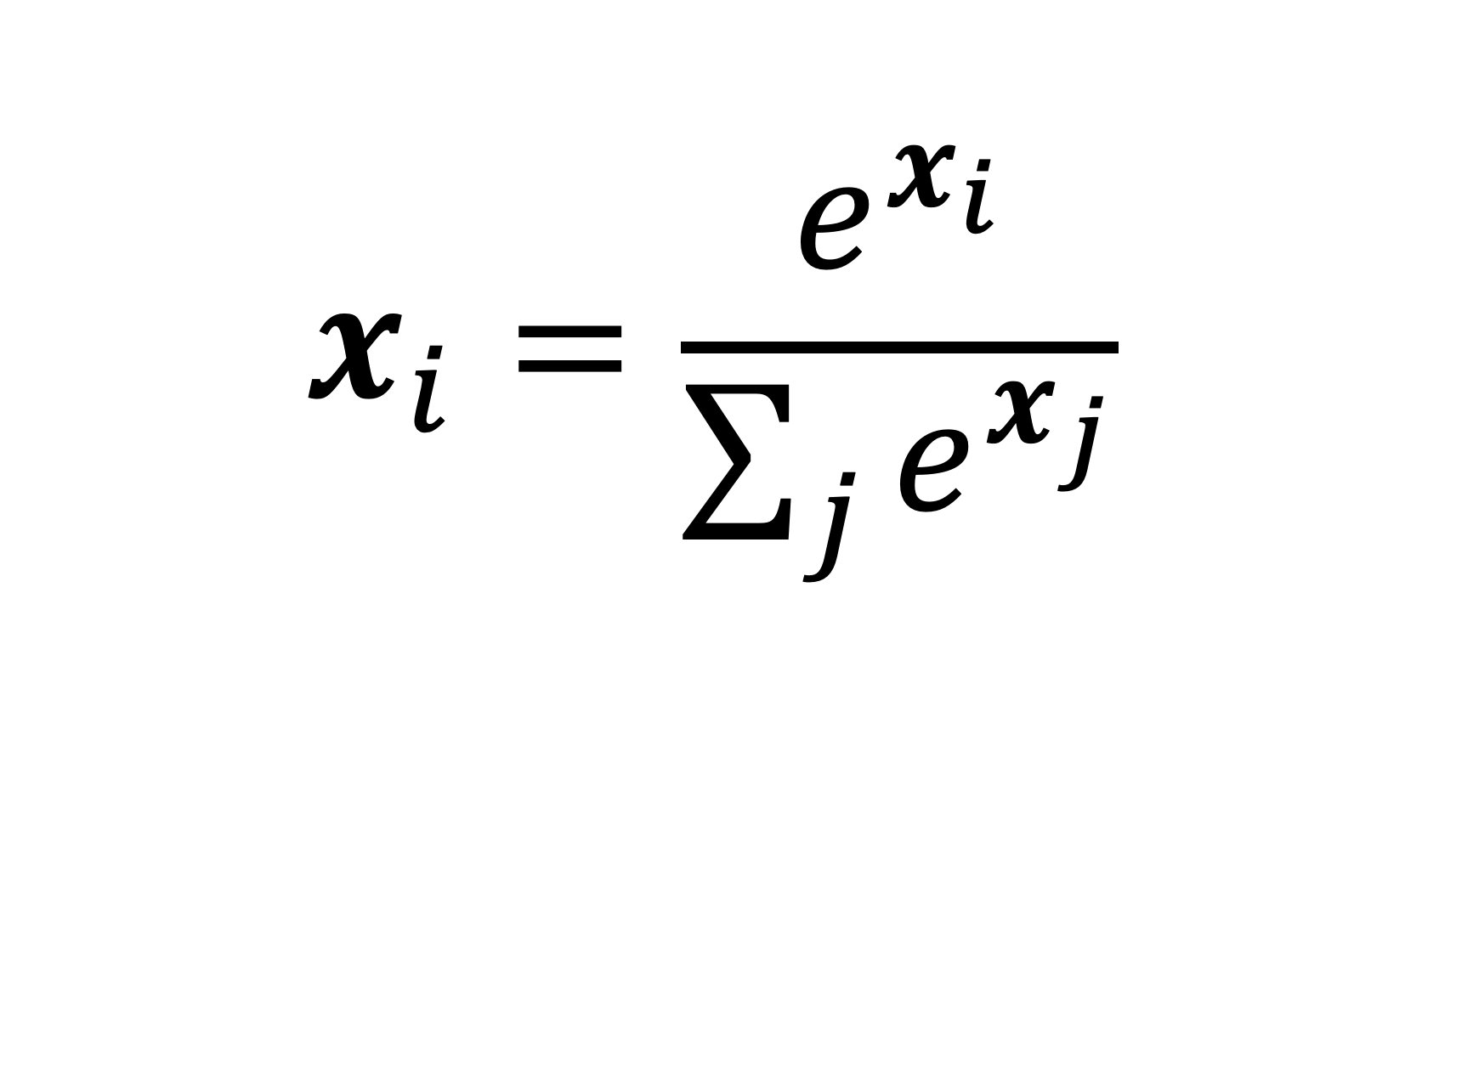
Solution: Softmax
Softmax maps an unbounded input vector to the range of 0 to 1, where the sum of all values adds to 1 (i.e. a probability distribution).
It is a monotonic function, meaning the largest input will still be the largest output.
It comes from multinomial logistic regression in statistics.
$$x_{i}=\frac{e^{x_{i}}}{\sum_{j}{e^{x_{j}}}}$$

Slide 24
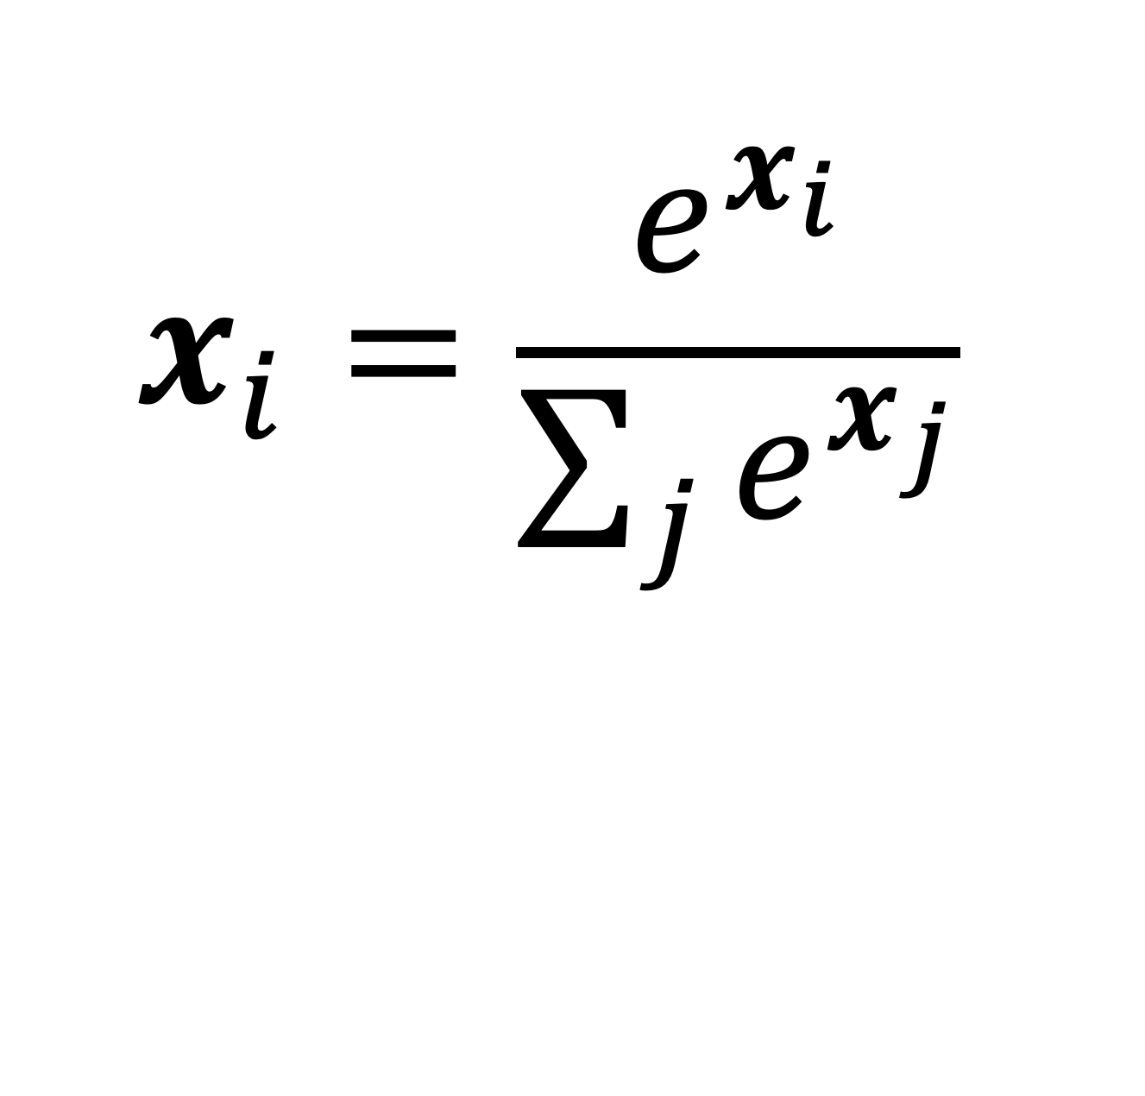
Example: Softmax
$$x_{i}=\frac{e^{x_{i}}}{\sum_{j}{e^{x_{j}}}}$$
cat
3.2
car
5.1
-1.7
frog

Slide 25
Example: Softmax
$$x_{i}=\frac{e^{x_{i}}}{\sum_{j}{e^{x_{j}}}}$$
cat
3.2
car
5.1
-1.7
frog
unnormalized log probabilities

Slide 26
Example: Softmax
$$x_{i}=\frac{e^{x_{i}}}{\sum_{j}{e^{x_{j}}}}$$
unnormalized probabilities
cat
3.2
24.5
exp
car
5.1
164.0
-1.7
0.18
frog
unnormalized log probabilities

Slide 27
Example: Softmax
$$x_{i}=\frac{e^{x_{i}}}{\sum_{j}{e^{x_{j}}}}$$
unnormalized probabilities
cat
3.2
24.5
0.13
exp
normalize
car
5.1
164.0
0.87
-1.7
0.18
0.00
frog
unnormalized log probabilities
probabilities

Slide 28
Last step:
How does the network know how well it did?

Slide 29
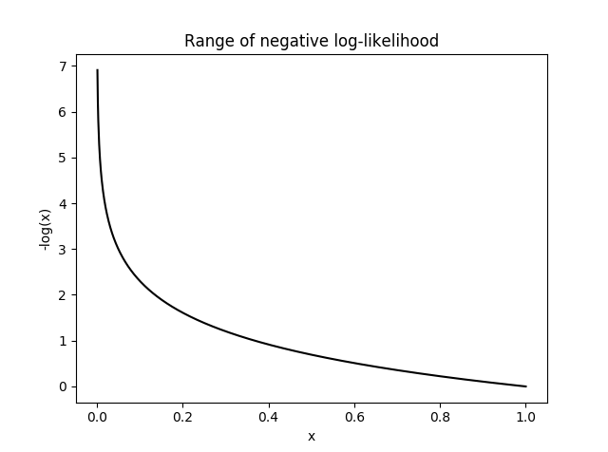
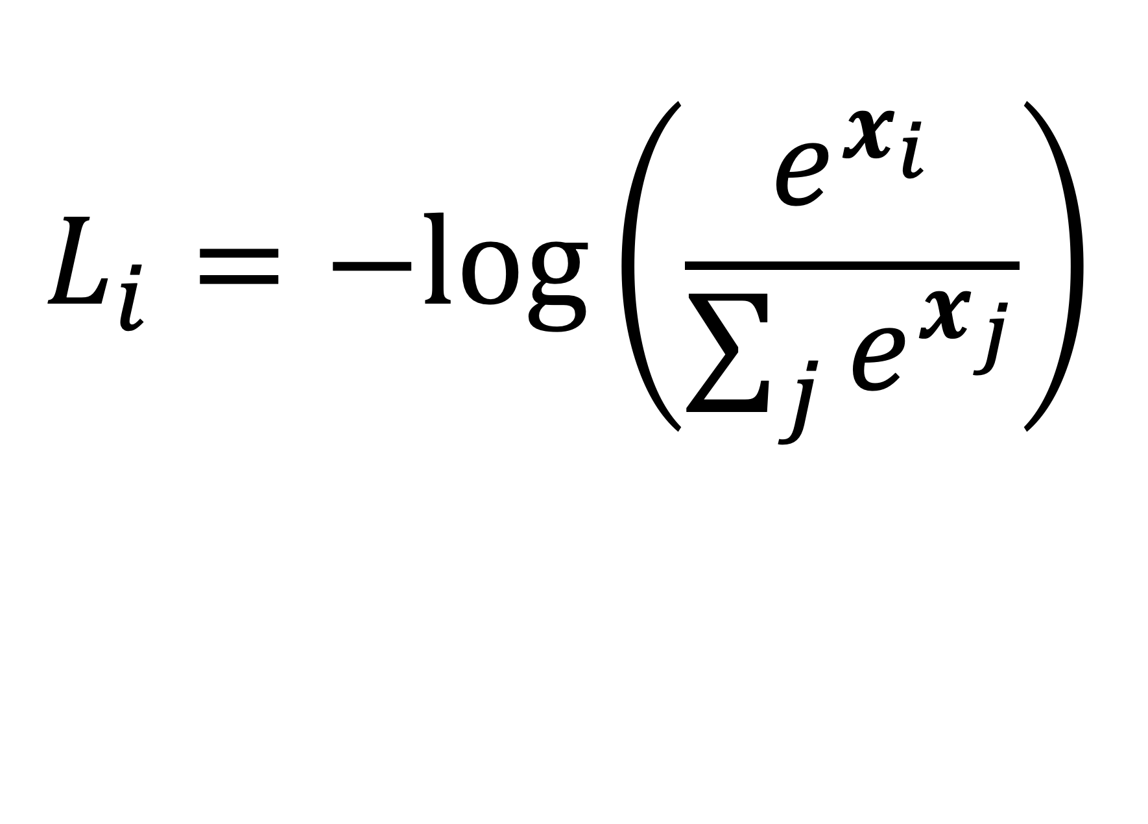
Solution: Negative Log
The negative of a log function maps an input range of (0,1] to [0,∞) in reverse order.
To assign a loss value for a given set of scores, take the softmax prediction confidence of the correct class and take its negative log. This is called Cross Entropy Loss.
A high confidence value close to 1 would approach 0 loss.
$$L_{i}=−log⁡\left(\frac{e^{x_{i}}}{\sum_{j}{e^{x_{j}}}}\right)$$
https://ljvmiranda921.github.io/notebook/2017/08/13/softmax-and-the-negative-log-likelihood/

Slide 30
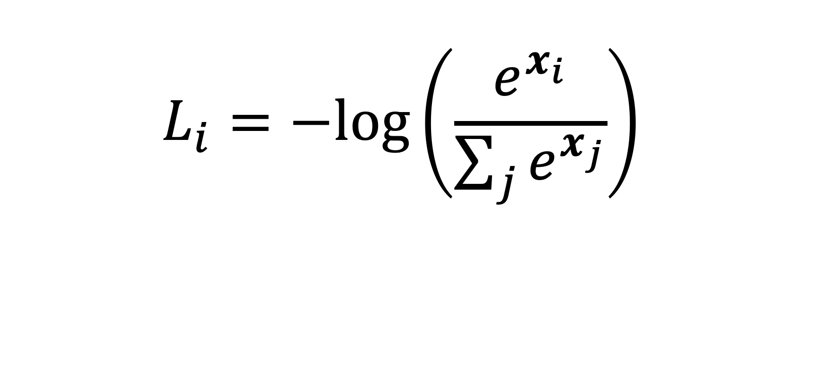
Cross Entropy Loss
$$L_{i}=−log⁡\left(\frac{e^{x_{i}}}{\sum_{j}{e^{x_{j}}}}\right)$$
unnormalized probabilities
cat
3.2
24.5
0.13
L_i = -log(0.13)
= 0.89
exp
normalize
car
5.1
164.0
0.87
-1.7
0.18
0.00
frog
unnormalized log probabilities
probabilities

Slide 31
Loss function/Optimization
Define a loss function that quantifies our unhappiness with the scores across the training data.
Come up with a way of efficiently finding the parameters that minimize the loss function. (optimization)
-3.45
-8.87
0.09
2.9
4.48
8.02
3.78
1.06
-0.36
-0.72
-0.51
6.04
5.31
-4.22
-4.19
3.58
4.49
-4.37
-2.09
-2.93
3.42
4.64
2.65
5.1
2.64
5.55
-4.34
-1.5
-4.79
6.14

Slide 32
Other Loss Functions
Classification
  Binary Cross Entropy (with Logits)
  Hinge Loss
Other Tasks
  Mean-squared Error (MSE)
  L1 Loss (MAE)
  Cosine Similarity

Slide 33


